Slide 1

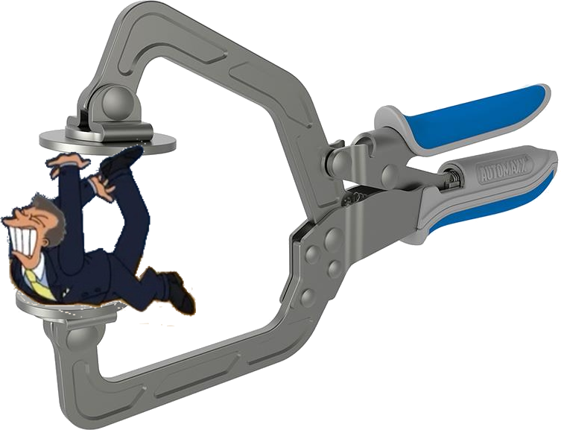
Applications of Hashbytes and Compress Functions
www.linkedin.com/in/nowiski
Jeff Nowiski
Twitter: @sqljackalope

Slide 2
Who am I?
Jeff Nowiski
Database Engineer @ ChannelAdvisor
First SQL Saturday Talk (please provide feedback)
SQL Server Interests: PowerShell, Tuning, Design, SSIS

Slide 3
Overview
Hashing
Summary of Hashing Functions
Hashing for uniqueness example
Compression
Summary of Compression Options
Compression example
Compression in plain sight example

Slide 4

Hash Functions
Allows a value of arbitrary size to be mapped to a fixed size value
Goal is to have a uniform distribution of data after “hashing”
Provided enough values collisions will happen

Slide 5
Odds of a hash collision
Number of Values Generated
 | 128bit (md5) | 160bit (SHA1) | 256bit (SHA-256) | Similar Odds
1 in 4 | 1.3E+19 | 8.55E+23 | 2.41E+38 | US President went to Harvard (1 in 3.58)
1 in 100,000 | 8.25E+16 | 5.41E+21 | 1.52E+36 | ER visit for a pogo stick injury (1 in 115,300)
1 in a million | 2.61E+16 | 1.71E+21 | 4.81E+35 | Getting Attacked by a shark (1 in 11.5 million)
1 in a billion | 8.25E+14 | 5.41E+19 | 1.52E+34 | Reality is not a simulation by superintelligence (1 in billions) **Elon Musk
1 in a hundred trillion | 2.61E+13 | 1.71E+18 | 4.81E+32 | Odds of a meteor landing on your house (1 in 182 trillion)
Calculations based upon: http://preshing.com/20110504/hash-collision-probabilities/

Slide 6
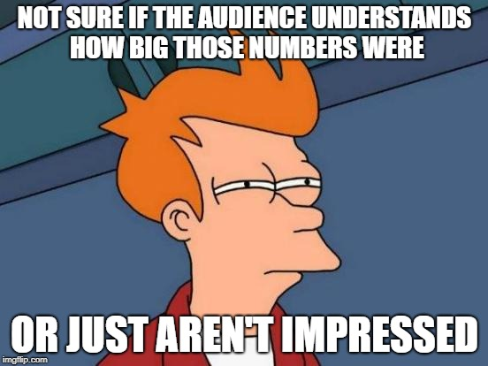

Slide 7
Real World Use Case
Code First
Many versions of similar but not identical code were deployed
Most tables had a single PK on an Identity value
dta generated indexes
Natural keys were wide but not enforced
So when duplicates made it in they had to be cleaned up manually
Lookups by natural keys caused table scans

Slide 8

Hashing Demo

Slide 9

Compression
Types of Compression in SQL Server
Page/Row Compression
Columnstore
Compress Function
Uses GZIP compression

Slide 10
Real World Use Case
For debugging and stats tracking we log ORM generated queries
Entity Framework + OData = big verbose queries
This is a bad idea but we do it anyway

Slide 11
“Give ‘em the clamps” (demo time)

Slide 12
Compress Savings
8 million row table
Single NVARCHAR(max) column
Longest Value = 37043 characters
Average Value = 508 characters
Created a text log of activity in the StackOverflow database, so its user submitted text not the same string over and over.

Slide 13
Review - When to use Hashing
Wide string data to ensure uniqueness
When most of the values are larger than the hash size
Don’t hash a short string as the output hash would be larger than the input
When you want to perform quick equality searches
When you want to reduce your composite key size
Concatenate and hash several columns into one (make sure you add a separator)
When you aren’t doing this for crypto/security
There are better solutions than hashing for this

Slide 14
Review - When to use Compress
Wide string data
When you care more about space reduction than speed
When you never search based on this field
When your bottleneck is not CPU already (maybe)
Your experience may vary but its worth thinking about the extra CPU

Slide 15

Questions/Comments

